Slide 1
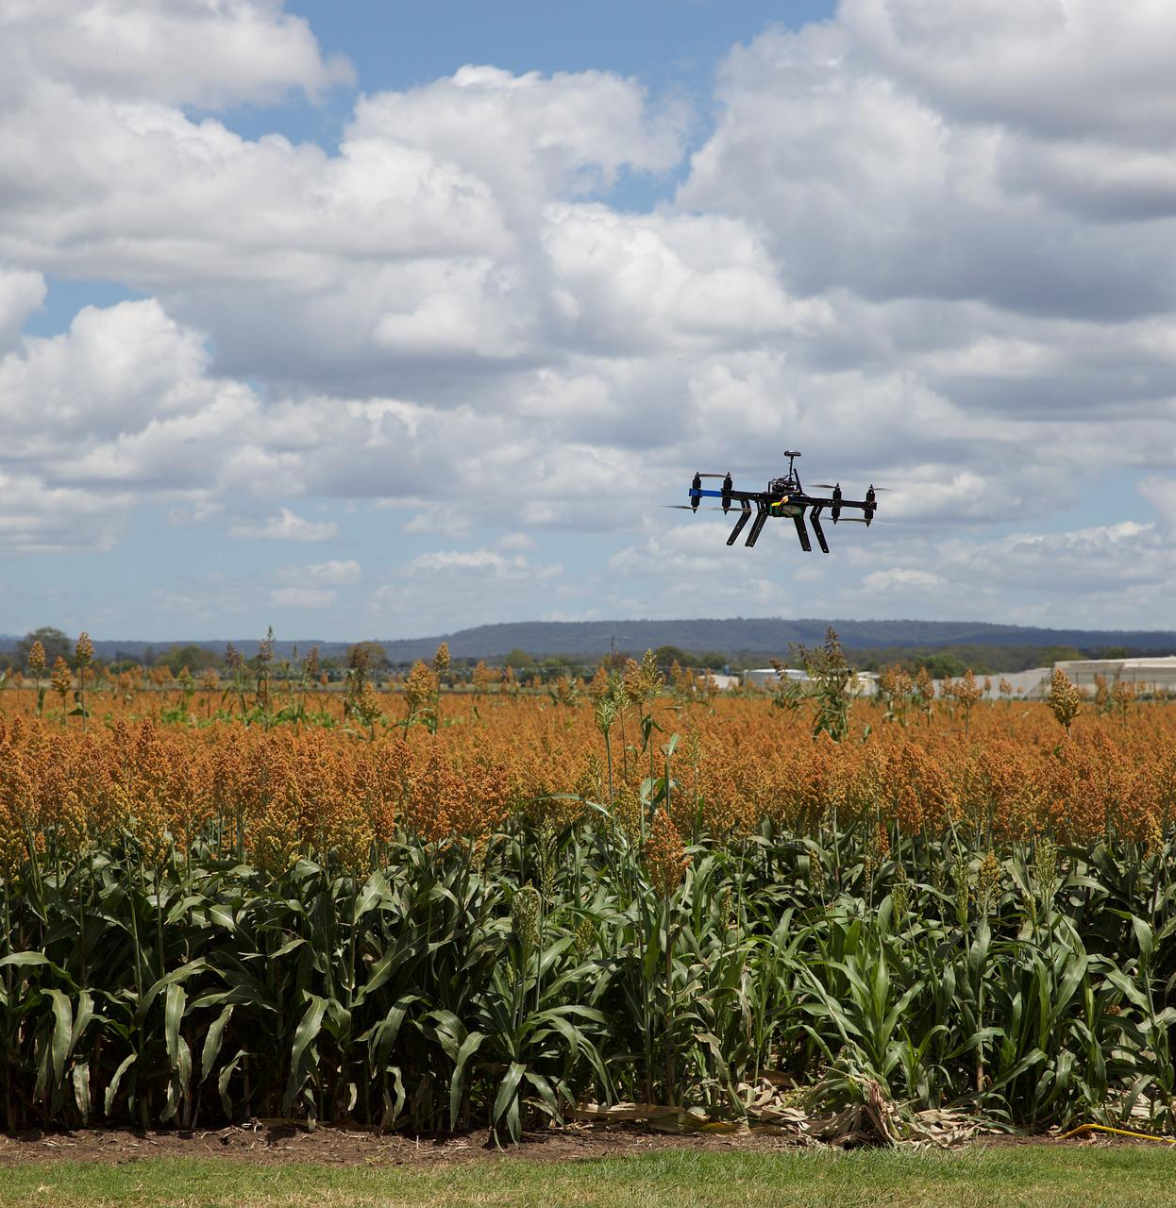
Precision Farming Using Autonomous Vehicle
Group A1:
Jaouaher Belgacem Jasmeet Singh Matta
Arsany Grigis
[1]
Notes:
Line spacing + Page numbers

Slide 2
The Software Modelling

Slide 3
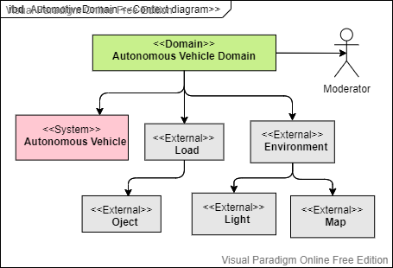
Context Diagram

Slide 4
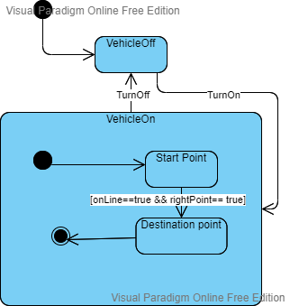
State MachineDiagram

Slide 5
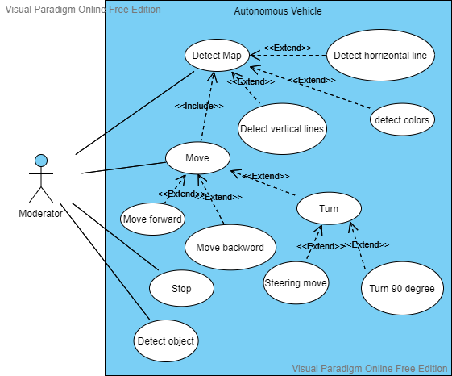
Use Case Diagram

Slide 6
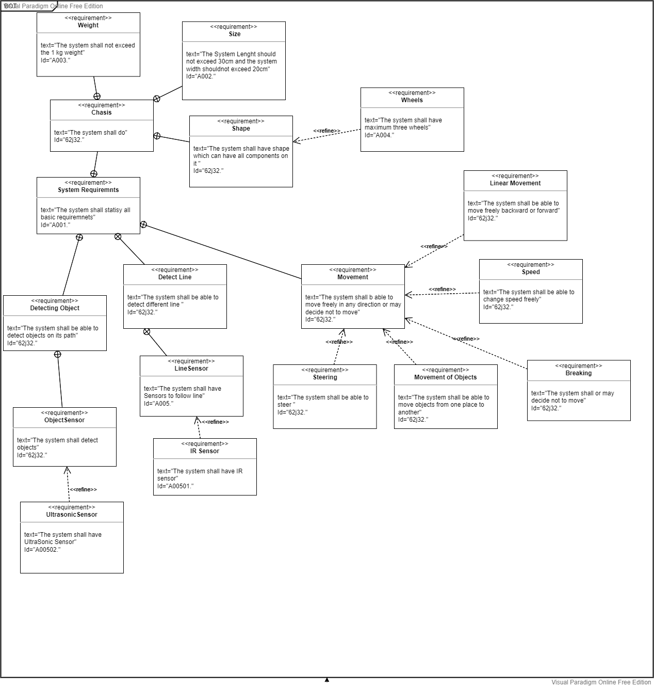
Requirement Diagram

Slide 7
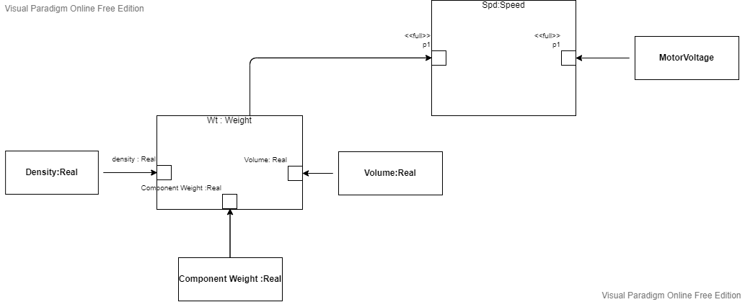
Parametric Diagram

Slide 8
The Hardware Modelling

Slide 9

Design Inspiration
[1]

Slide 10
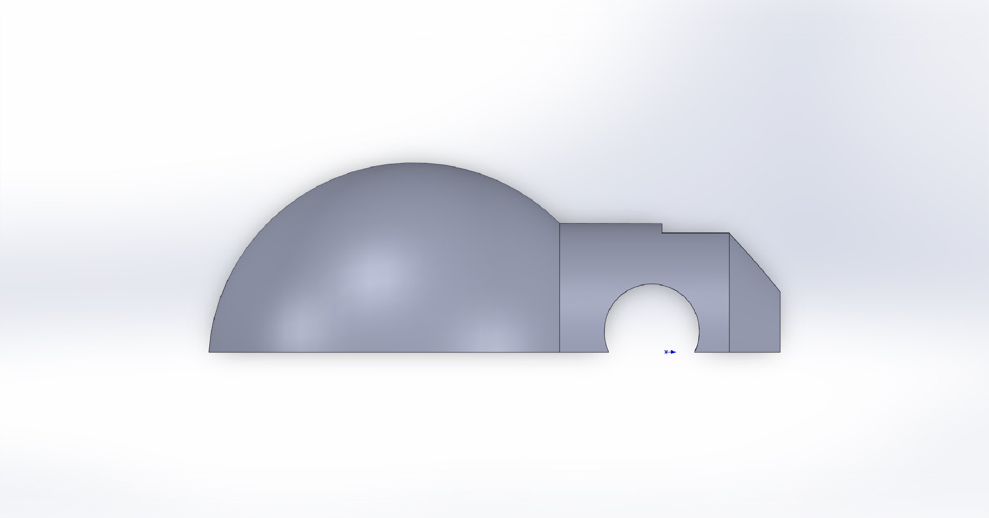
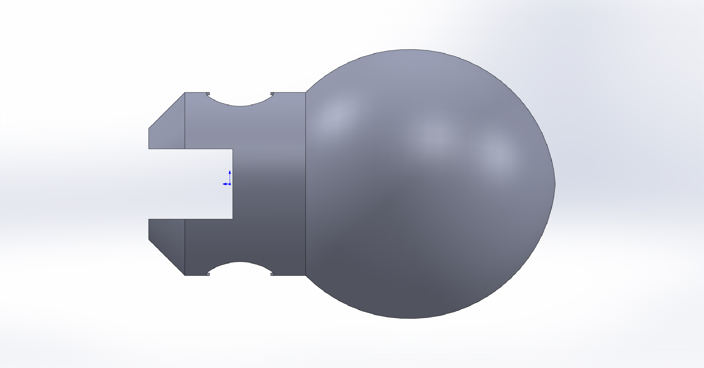
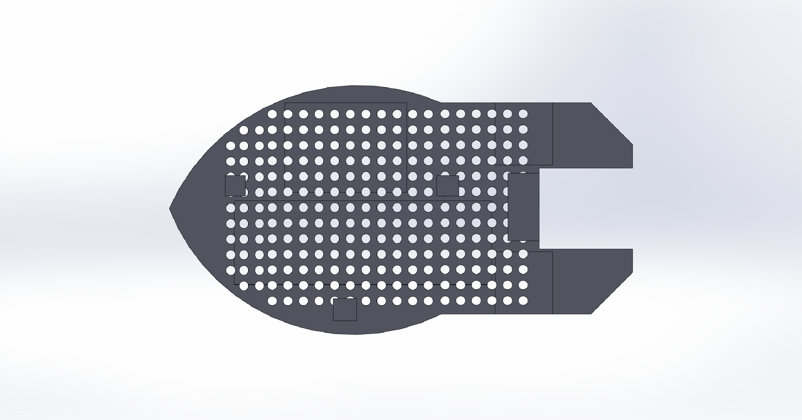
Design
[1]

Slide 11
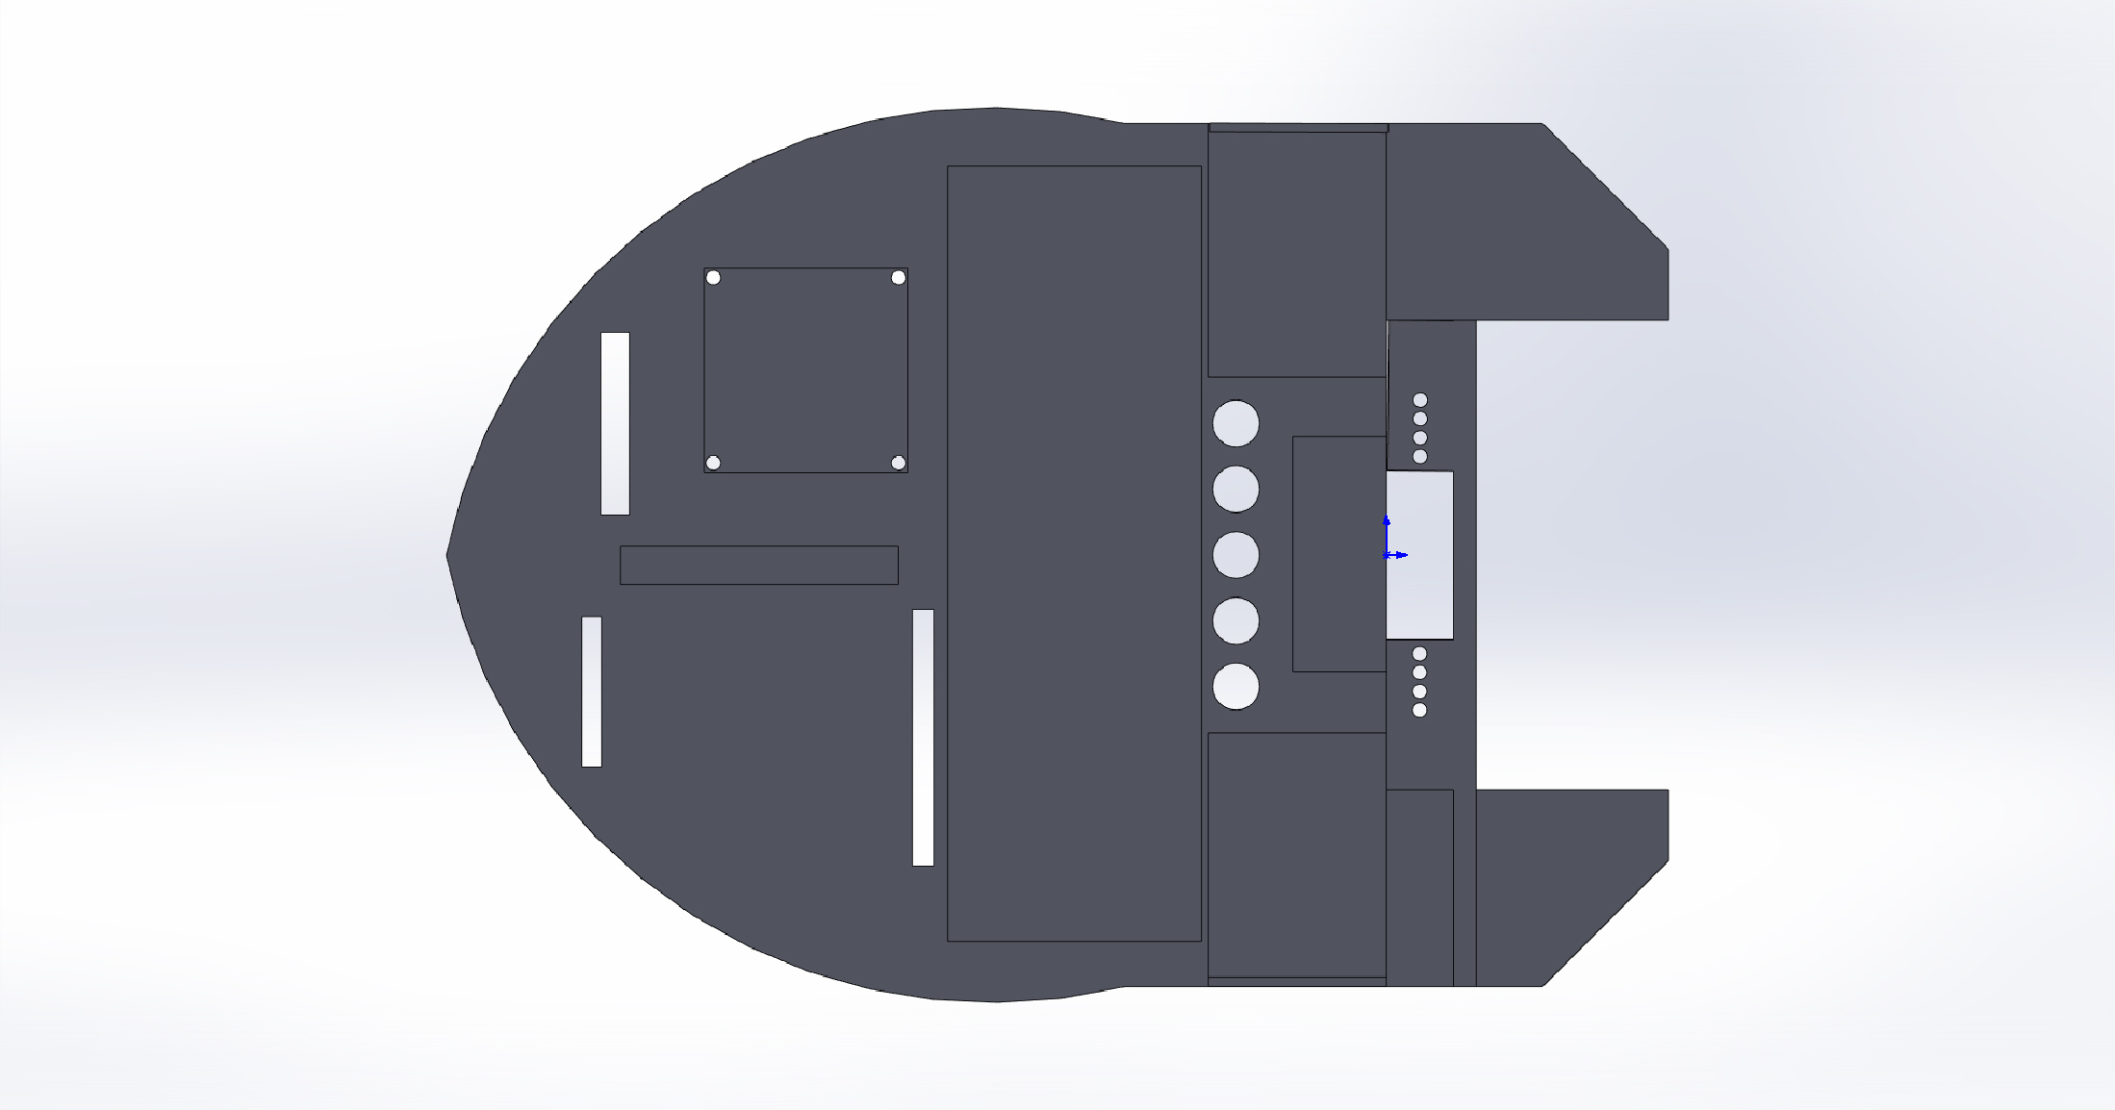
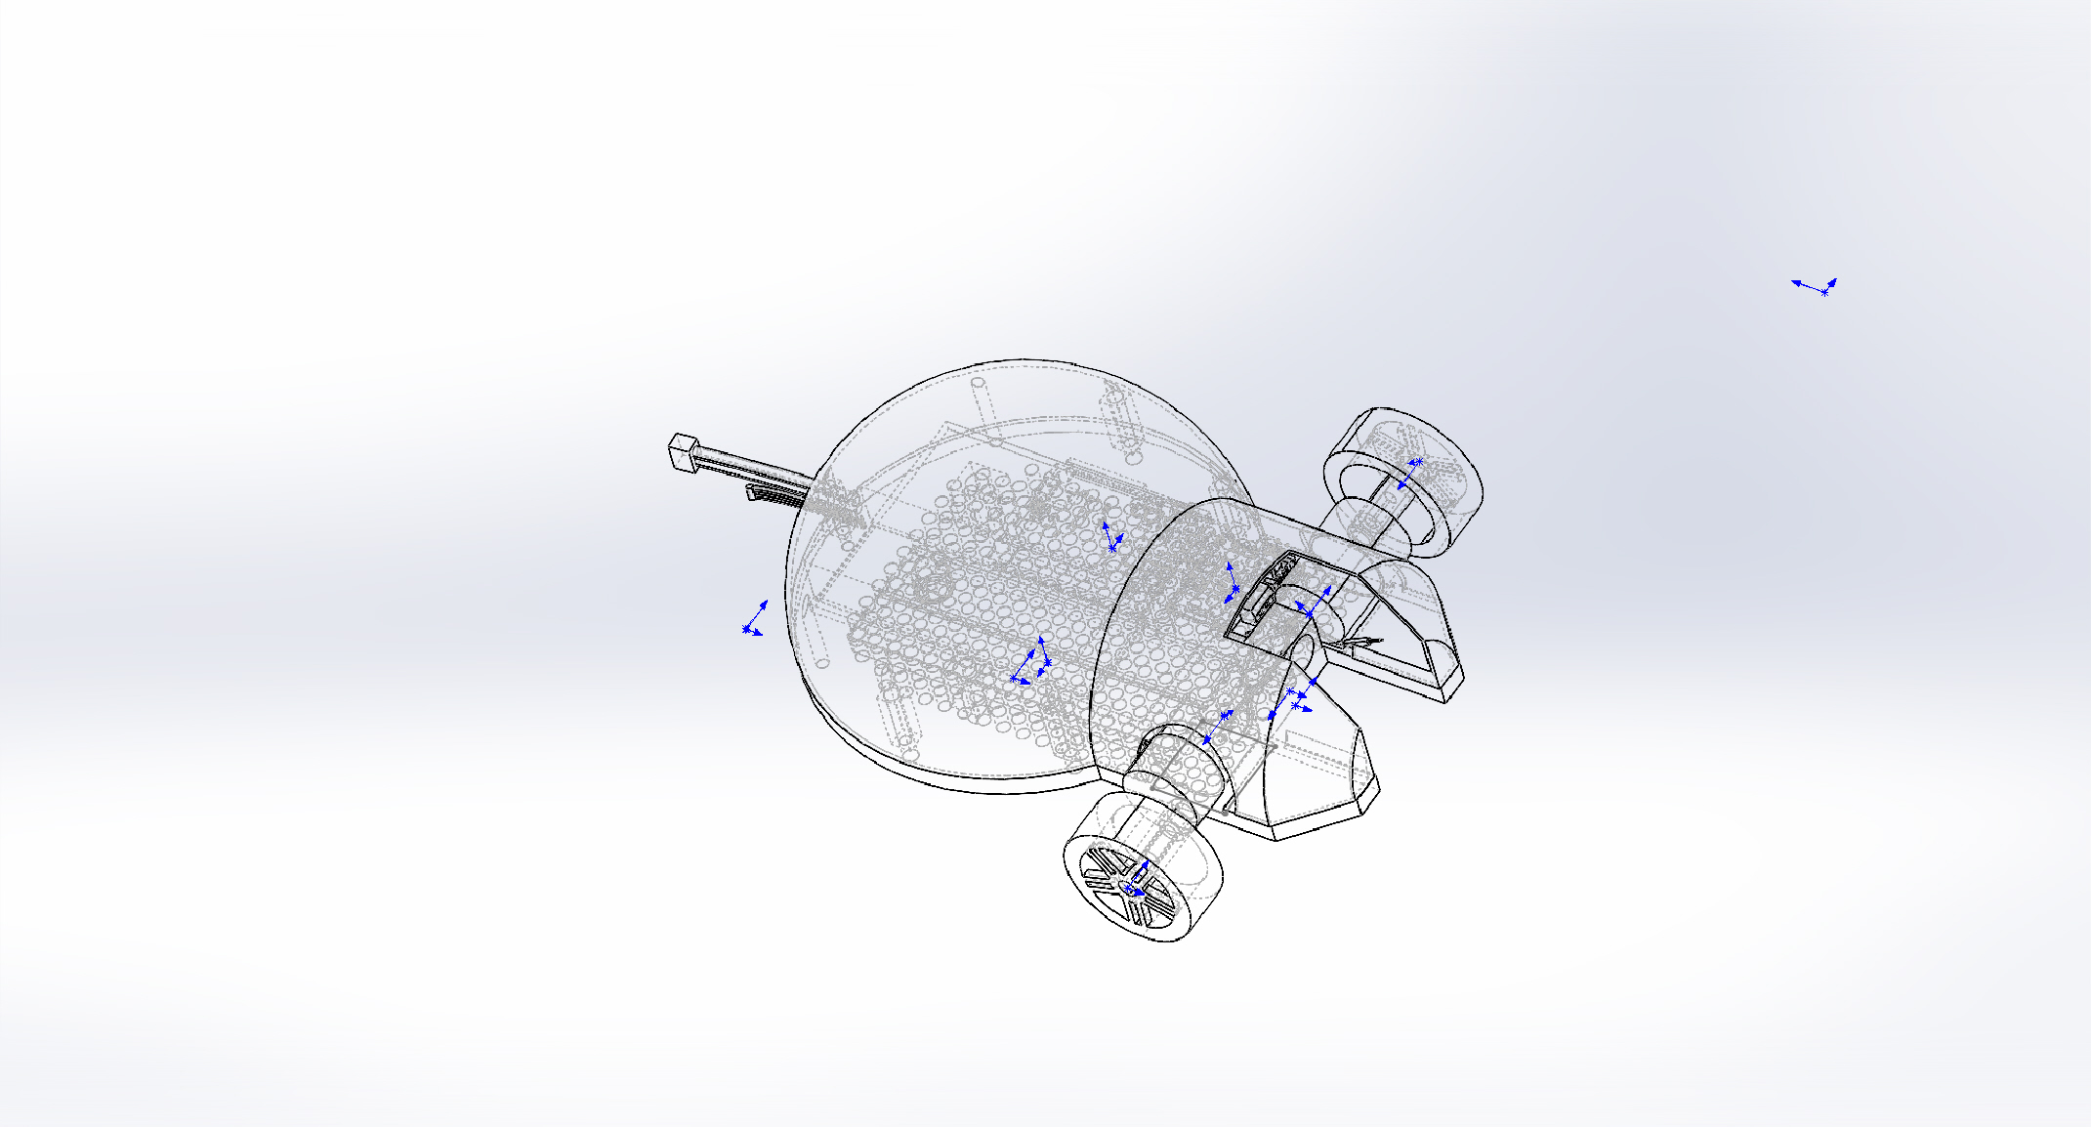
Design
[1]

Slide 12
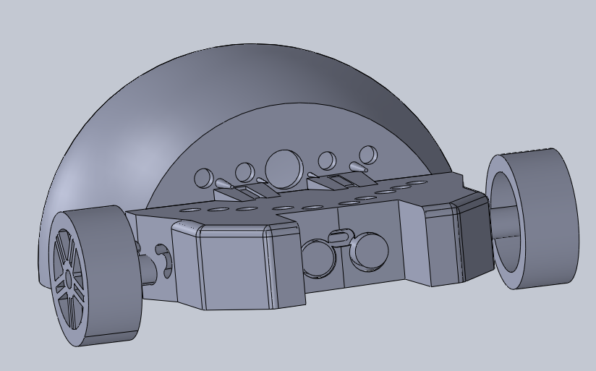
Final Design

Slide 13
Code Implemetation

Slide 14
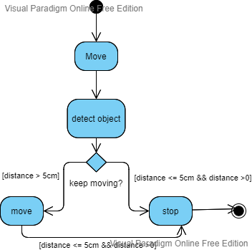
Object Detection

Slide 15
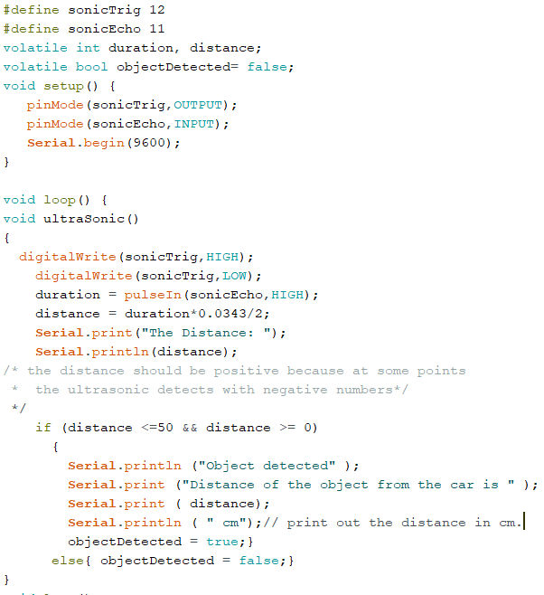
Object Detection

Slide 16
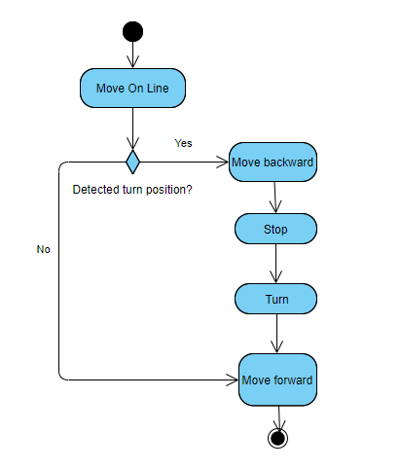
90° Turn

Slide 17
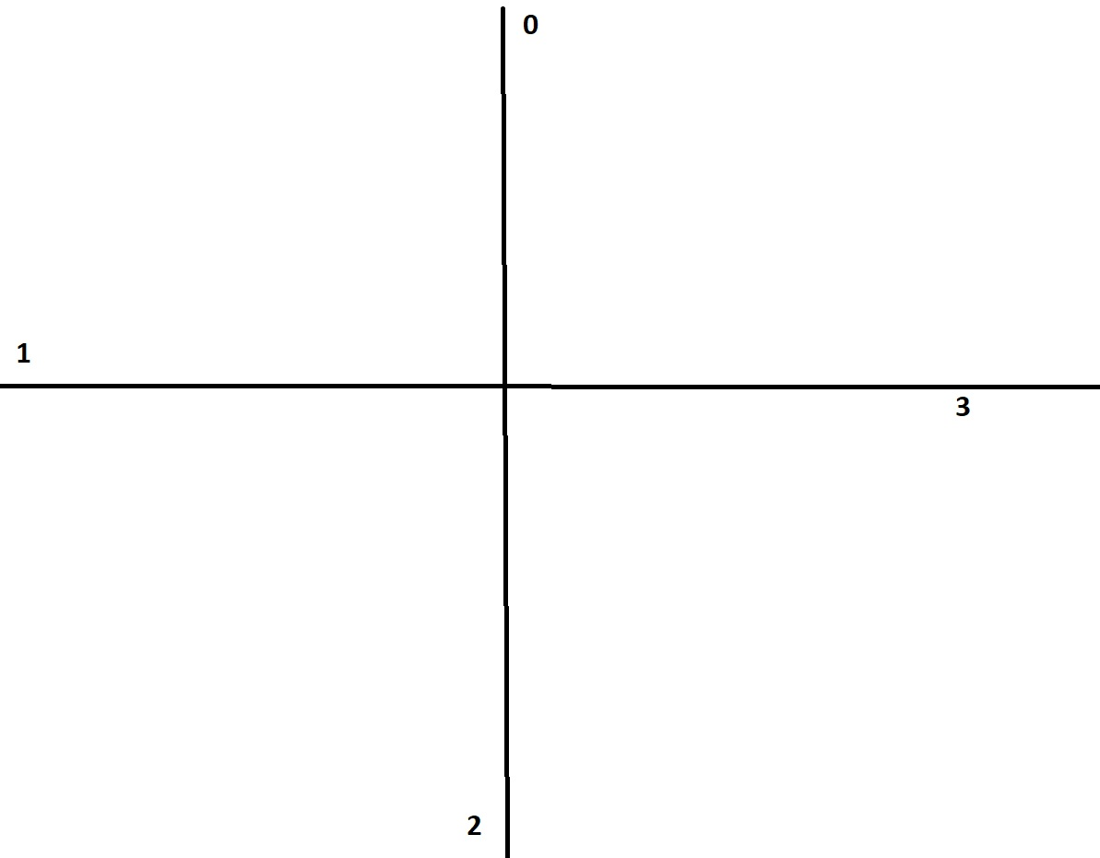
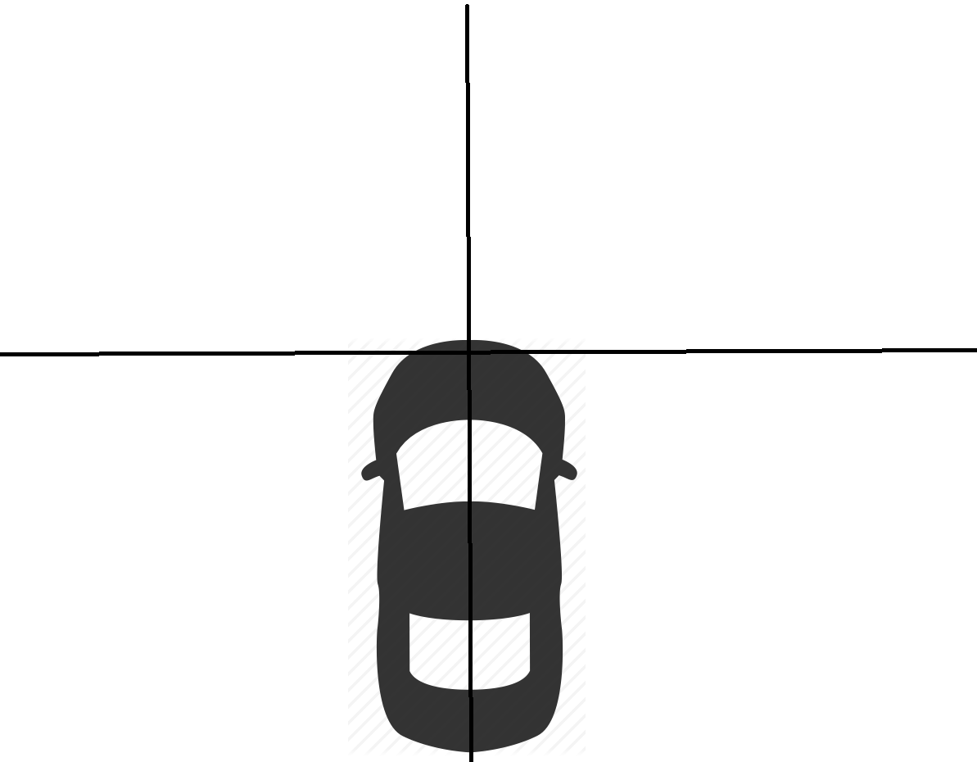
Mapping

Slide 18
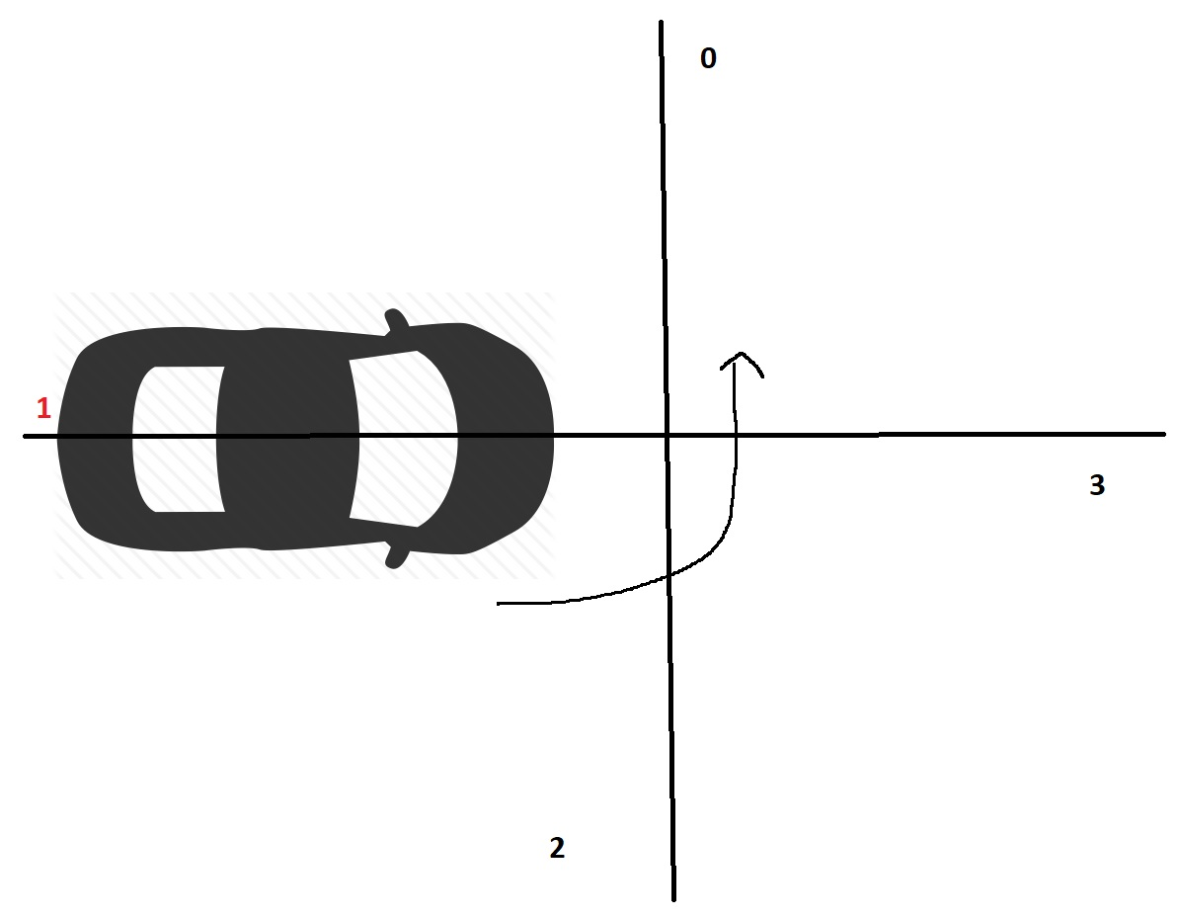
Algorithm

Slide 19
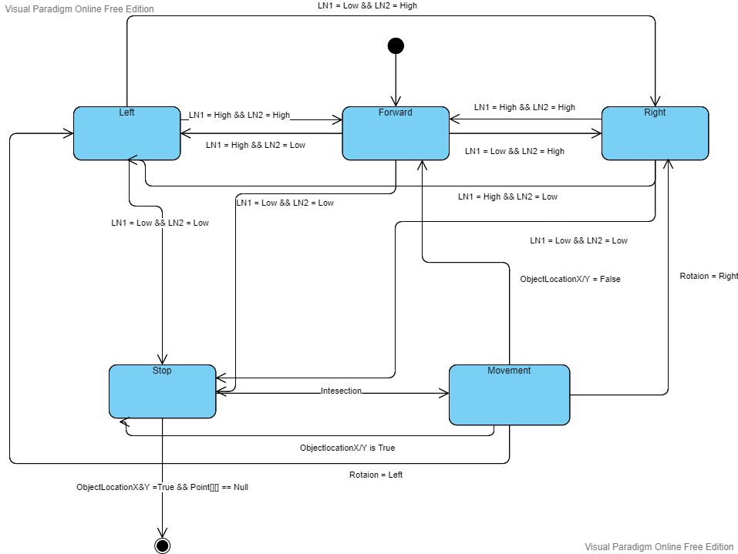
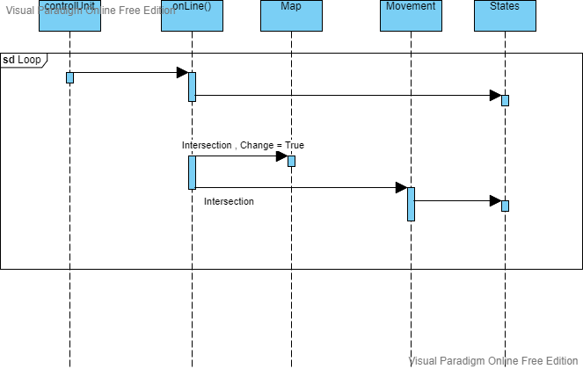
Algorithm

Slide 20
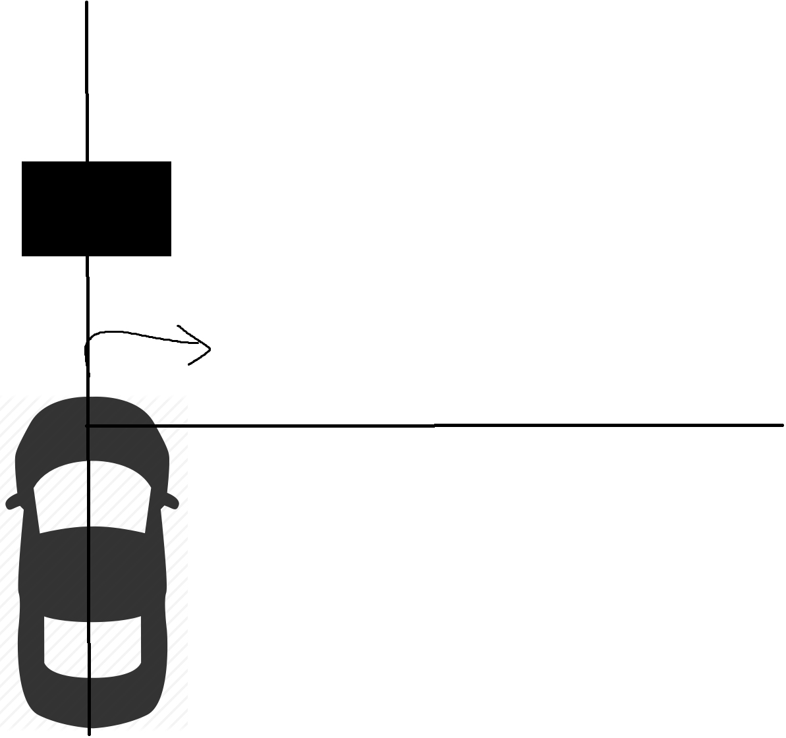
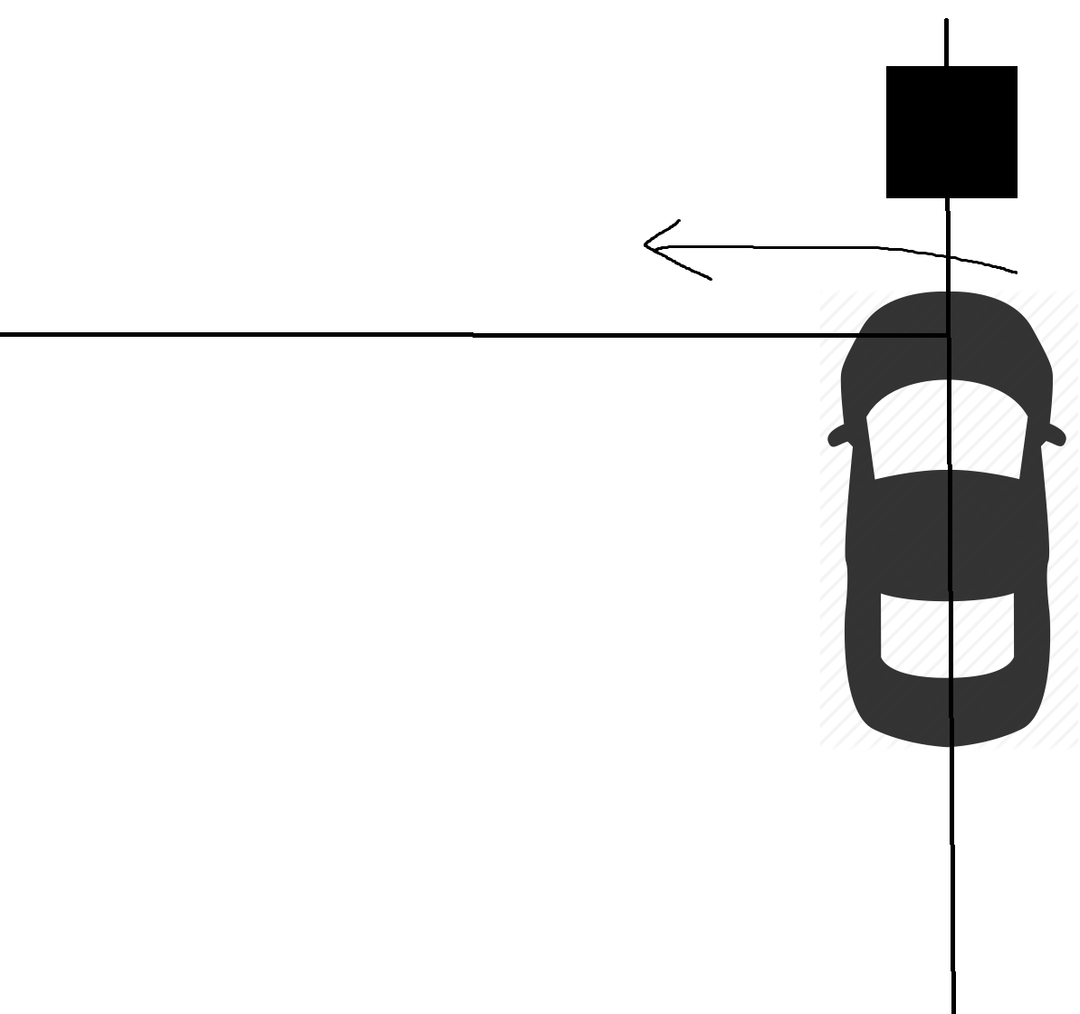
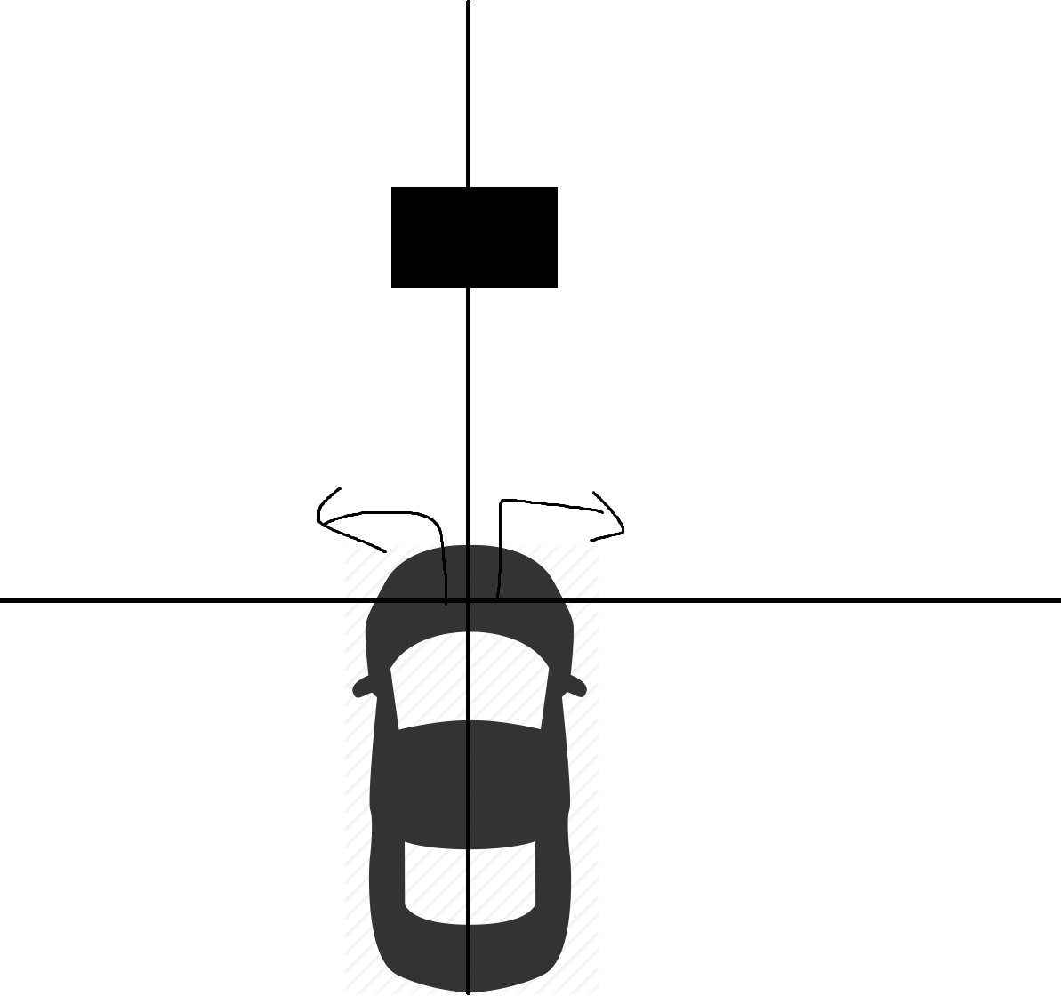
Obstacle Avoidance

Slide 21
Sources
1: pixabay.com

Slide 22
THANK YOU FOR YOUR ATTENTION

